Slide 1

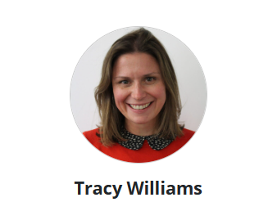
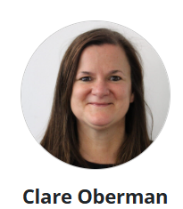
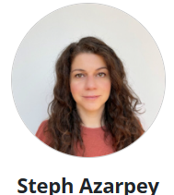
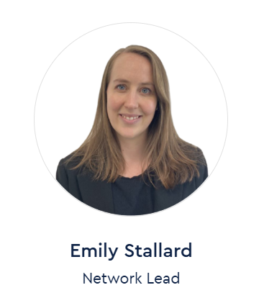
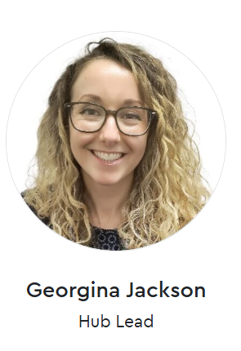
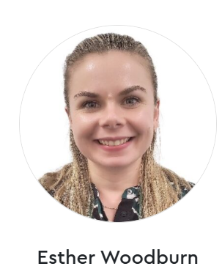


The National Consortium for Language Education is England’s flagship programme for Languages: research-informed, partnership-based and funded by the Department for Education. NCLE is a consortium of three partners: IOE, UCL’s Faculty of Education and Society, the British Council and the Goethe-Institut.
NCLE intends to strengthen Languages Education in England through
evidence-based approaches to teaching and learning using two mechanisms.
Language Educators Online
Language Networks
NCLE has developed a free on-demand professional learning platform for Language teachers and leaders called Language Teachers Online. Or LEO for short! The platform provides:
The latest research into Language Teaching and Learning
An opportunity to see what this might look like in the classroom with recently recorded footage from French, Spanish and German classrooms across the country.
Flexible learning pathways, in bite-sized chunks and it’s completely free!
Language teachers and leaders can sign up to access LEO - Language Educators Online - NCLE
NCLE leads 14 Language Networks, located across England. From September 2025, the three West Midlands Language Networks will work collaboratively to broaden their reach and offer CPD to more schools across the West Midlands.
Grand Union Language Network is based at Tudor Grange Academy in Solihull.
Swanswell Language Network is based at Sidney Stringer Academy in Coventry.
Trent and Tame Language Network is based at the Arthur Terry School in Birmingham and Painsley Catholic College in Staffordshire
Language teachers and leaders can access the FREE CPD offer from all three West Midlands Language Networks, regardless of where they are located in the region. Full details of the CPD offer for the 25-26 academic year can be found on the next page. Most CPD sessions are delivered after school as virtual webinars. There are also three face-to-face teach meets, focusing on the new French, Spanish and German GCSE content. Teachers can sign up to NCLE’s national newsletter or can sign up to their nearest language network’s mailing list (via the network website) to receive information about a more local offer.
Meet the West Midlands Regional Language Network Team
Trent and Tame
Swanswell
Grand Union
Trent and Tame Language Network
Swanswell Language Network
Grand Union Language Network
Notes:
Welcome to AT. Very short introduction from Sam.
Introductions of Tracy and Abby.
Welcome to the launch event of the Trent and Tame Language Hub.

Slide 2

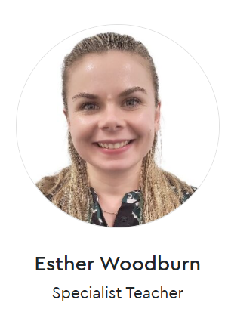
National and Regional FREE CPD Events during the 25-26 Academic Year
Wednesday 8th October 16:00-17:00 | An Introduction to LEO An introduction to NCLE new professional learning platform: LEO. Tour the interactive, flexible, and engaging professional learning platform in this webinar. Webinar Registration – Zoom
Wednesday 22nd October 13:00-16:00 Tudor Grange Academy | Spontaneous Speech and the new GCSE speaking exam In person Teach Meet During the session we’ll consider how we can develop genuine spontaneous speech, with examples and emerging success stories shared by schools across the region. We’ll also consider how to prepare students and staff for the upcoming mock speaking exams and engage in some moderation of sample speaking scripts. This face-to-face event will be run three times in different locations. Click on the school name where you want to attend the session (on the left) to sign up.
Tuesday 18th November 13:00-16:00 Arthur Terry School
Wednesday 3rd December 13:00-16:00 Sidney Stringer Academy
Thursday 13th November 15:30-16:30 | Embedding Phonics Grand Union Webinar https://shorturl.at/mSGeW
Wednesday 14th January 15:30-16:30 | Supporting Home Language Qualifications at GCSE and Beyond Swanswell Webinar https://shorturl.at/1GfVW
Wednesday 26th November 16.00 – 17.00 | Curriculum and Assessment Review: Languages education fit for purpose? Hear from stakeholders from the languages community discussing the recommendations from the Curriculum and Assessment Review. Webinar Registration – Zoom
Thursday 29th January 15:30-16:30 | Using AI for spontaneous speaking development Trent & Tame Webinar https://shorturl.at/ul83m
Wednesday 4th March 15:30-16:30 | Exploring different Curriculum models Grand Union Webinar https://shorturl.at/bznDR
Notes:
Welcome to AT. Very short introduction from Sam.
Introductions of Tracy and Abby.
Welcome to the launch event of the Trent and Tame Language Hub.

